Slide 1


Materials
Science
Division C
Georgia Tech Event Workshop Series 2024-25

Slide 2
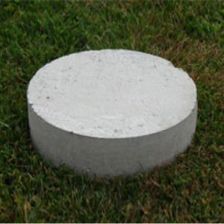
01
RULES SHEET
02
DIFFICULT TOPICS
03
COMMON QUESTIONS
04
TIPS FROM A VETERAN
05
OTHER FREE RESOURCES
Notes:
For Builds: Replace difficult topics with physical principles involved in the build and replace common questions with common designs

Slide 3
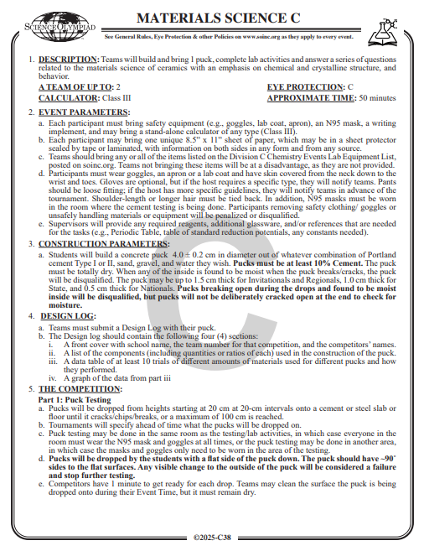
The Rules Sheet
Brief Description of Event:
3 parts: puck testing, written test, and lab activities
Written test is weighted the heaviest, followed by lab activities (usually physics-based)and puck testing
What to Bring:
Build (puck)
Lab equipment (found on page 74 of the rules)
N-95 mask
Design log
Pencils and calculator (can be graphing)
2 cheat sheets (one per participant)
Notes:
Highlight key points from the rules sheet: DESIGN LOGS that basically grant free points, most tested-on topics, point distribution so that competitors know what to prioritize, allowed notes and equipment, etc.

Slide 4

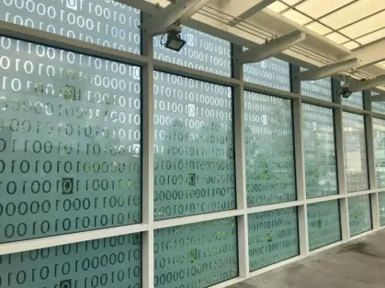
DIFFICULT TOPICS
Notes:
This section should focus on topics that are more math-based (harder to self-teach), concepts that come only usually up in college level courses, or concepts that you struggled with when you competed in this event

Slide 5
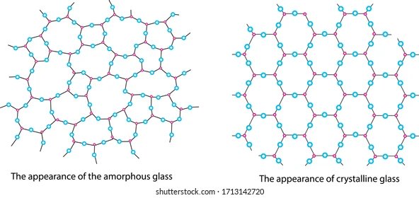
Topic 1: Structure
Largely chemistry-based
Amorphous Glasses: Randomly arranged atoms or molecules without long-range order.
Crystalline Ceramics: Atoms or ions arranged in a repeating lattice structure.
Defects: Imperfections in the structure that influence strength, conductivity, and durability.

Slide 6
Topic 2: Characterization
X-Ray Diffraction (XRD): Used for identifying crystalline phases, requiring an understanding of Bragg's law and diffraction patterns.
Scanning Electron Microscopy (SEM): Provides detailed imaging of surface structures, but interpreting micrographs can be non-trivial.
Interpreting complex datasets and understanding instrument limitations.

Slide 7
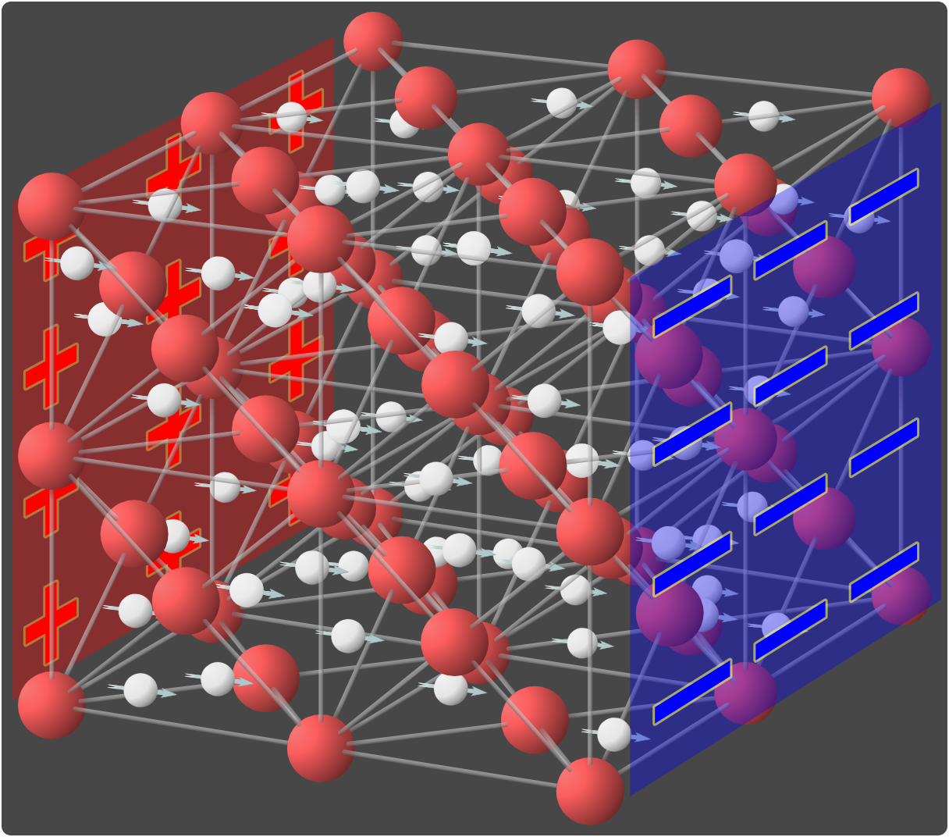
Topic 3: Thermal & Electrical Properties
Thermal Properties: Include conductivity, expansion, and resistance to thermal shock.
Electrical Properties: Dielectric strength, conductivity, piezoelectricity, and ionic conductivity.
Complexity: Requires linking atomic-level phenomena to macroscopic behavior.
Notes:
Feel free to add more topics and make sure that there are plenty of pictures/diagrams!

Slide 8

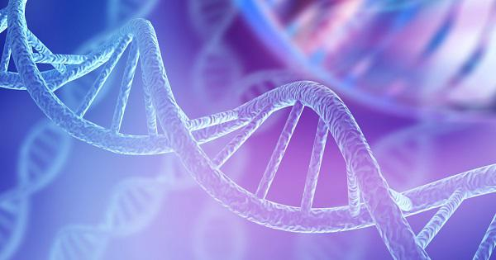
COMMON QUESTIONS
All of the following questions have been pulled from past YJI exams (which can be found on our website) or the Text Exchange on SciOly Wiki
Notes:
\

Slide 9
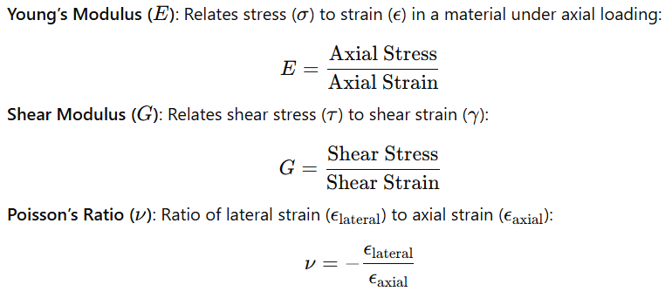
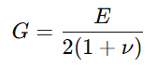
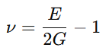
Question 1
Using Young’s modulus and shear modulus, derive an equation that relates those two and produces Poisson’s ratio. Then calculate Poisson’s ratio with that equation
Notes:
Pull some questions from exams on the scioly wiki test exchange, first give attendees a couple minutes to read over them/work through them, then walk them through the answers. Try to get a mix of multiple choice and short answer or matching

Slide 10
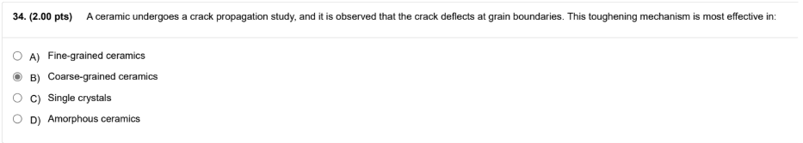
Question 2
Notes:
Pull some questions from exams on the scioly wiki test exchange, first give attendees a couple minutes to read over them/work through them, then walk them through the answers

Slide 11
Question 3
During cold working of metals, the increase in strength and hardness is primarily due to:
A) Reduction in grain size
B) Increased dislocation density
C) Formation of a more ductile phase
D) Decrease in atomic packing factor
Notes:
Pull some questions from exams on the scioly wiki test exchange, first give attendees a couple minutes to read over them/work through them, then walk them through the answers

Slide 12
Tips from a Veteran
Make sure you read over the entire rules sheet!
Even if you’re not confident with your build, make/bring a design log.
If you don’t have access to a lab for practice, look over previous tests’ lab components and plan out how you would approach that specific type of lab.
If you don’t have a strong background in chemistry or physics, borrow a textbook from your school to learn some foundational knowledge.
Notes:
Use this section to talk about any strategies you used to navigate the event when you competed. For example, how did you manage your time, how did you organize your notes, how did you split topics up between you and your partner, etc.?

Slide 13
Additional Resources
MIT- Intro to Solid State Chemistry Course
Previous tests through scioly wiki test exchange or websites of specific major invitationals
SUBWAY STATIONS
NC State Scioly Resource Page
WebMO Online Molecular Modeling
Yes, Saturn is the ringed one. This planet is a gas giant, and it’s composed mostly of hydrogen and helium
Notes:
Here, you can link or mention any online or book resources that helped you in this event when you were a competitor. Try to avoid general resources like scioly wiki, because they probably already are familiar with it.

Slide 14
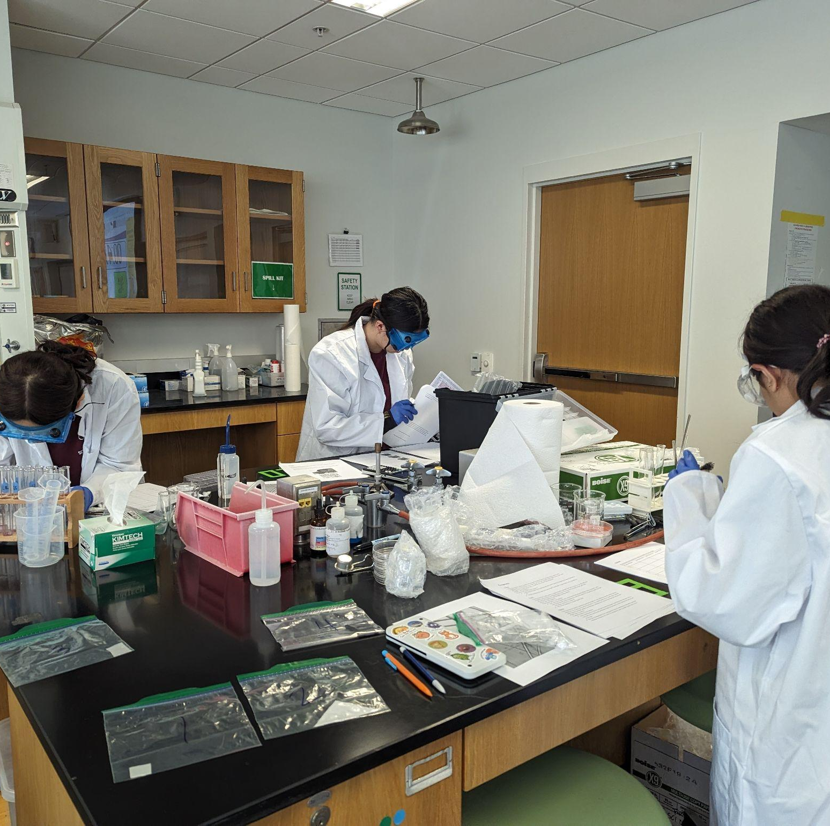
THANKS!
Notes:
(replace picture with a picture from one of our tournaments)

